Slide 1






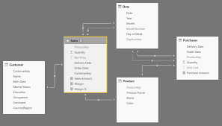

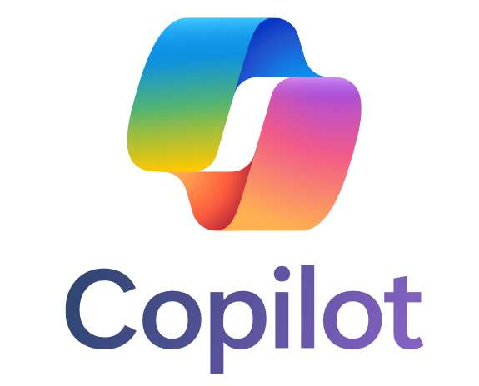
Chat History Analytics + AI Semantic Cache
User
Prepackaged Analytics/Semantic Models/Reports/Notebooks
Chat History
Mirroring
Storage
Fully Packaged Analytics
Notes:
ALP Key Takeaways / August 2024:
S3 bucket / copying for 100’s of customers in S3 buckets
On-going maintenance of that /
S3 bucket / majority of customers would take it / download it into Power BI and or Tableau
This new solution would shortcut all maintenance / allow to meet users where they are
Competitive advantage for us – its insane not to take advantage of it

Slide 2
Inventory – Analytics Artifacts
Power BI
Power BI Copilot Created User Engagement Report
Power BI Multiple Tab Dashboard
Power BI Semantic Model – Conversations / Users / Feedback & complex calculations
Cosmos Sample Documents
Conversations
Feedback
Users
Fabric
SQL views for parsing conversations document
SQL queries for new and returning user logic
Notebook for sentiment analysis scoring on user feedback

Slide 3
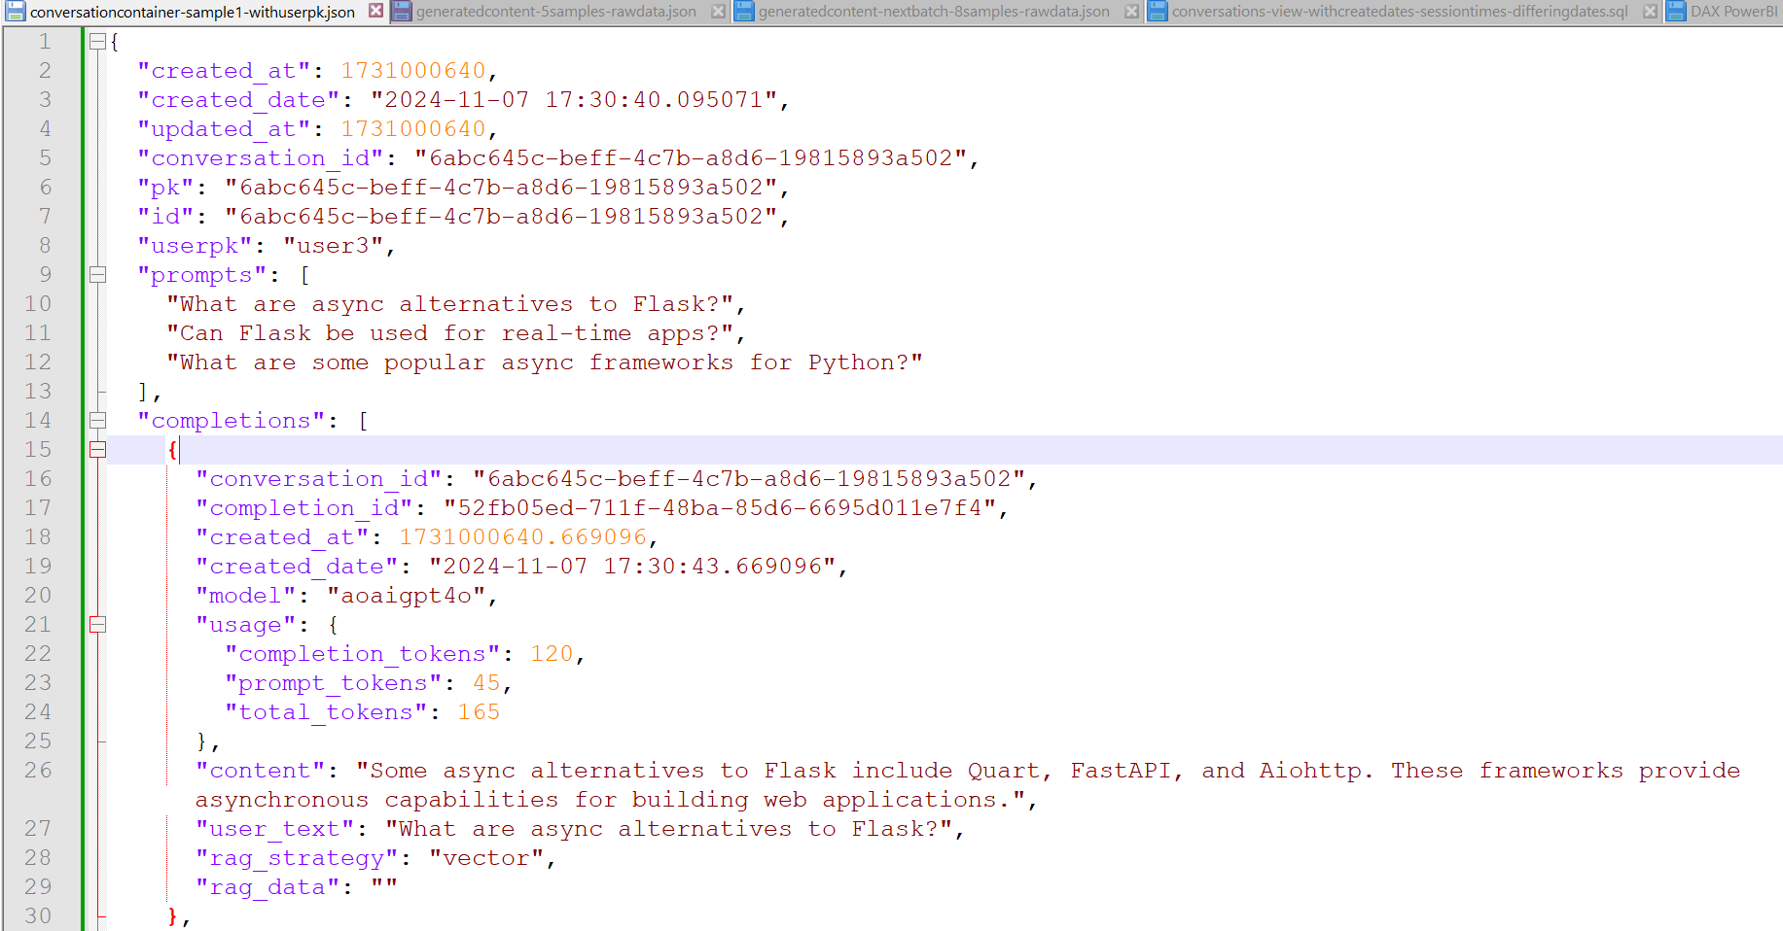
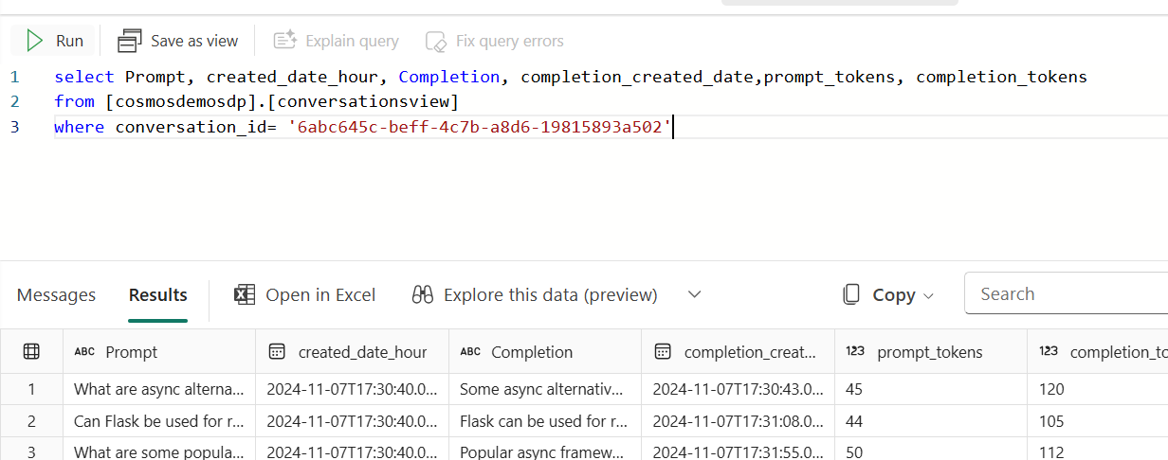
LLM Analytics
CosmosAIGraph /https://github.com/AzureCosmosDB/CosmosAIGraph/tree/main
Sample document with Fabric Mirroring Turned On

Slide 4
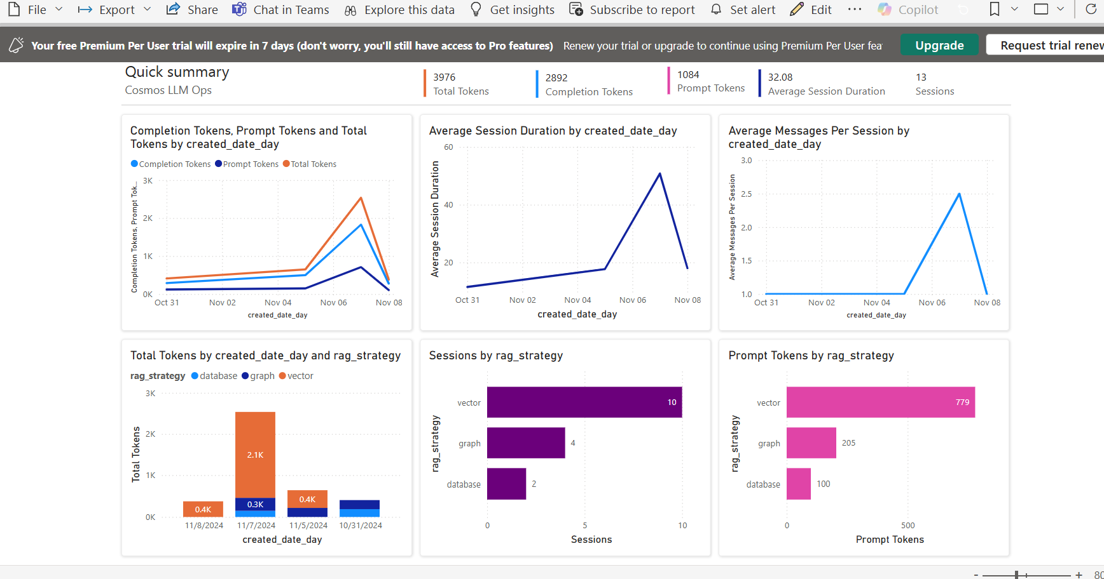
LLM Analytics
Power BI Copilot Created Content

Slide 5
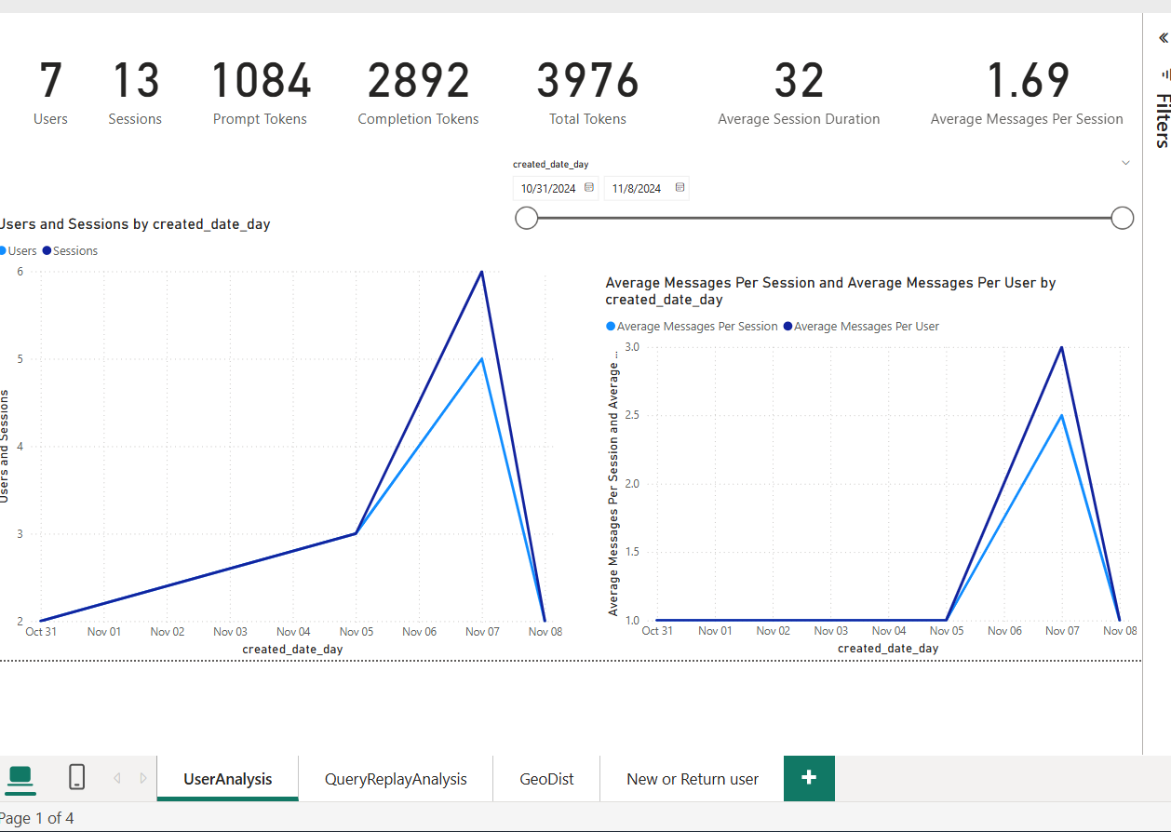
LLM Analytics
User / Usage Analysis Trends

Slide 6
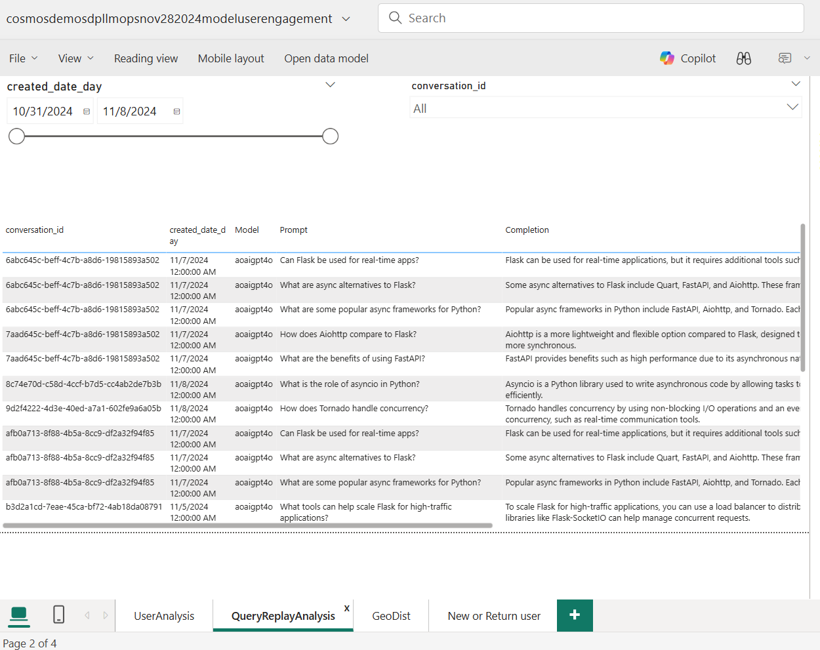
LLM Analytics
Conversation Analytics by date / user / conversation

Slide 7
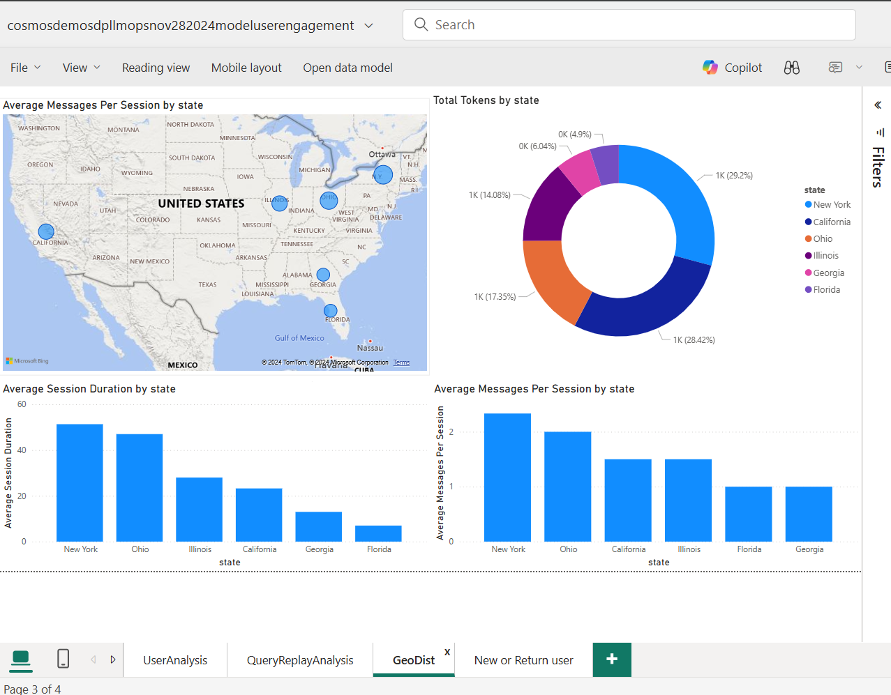
LLM Analytics
User Distribution

Slide 8
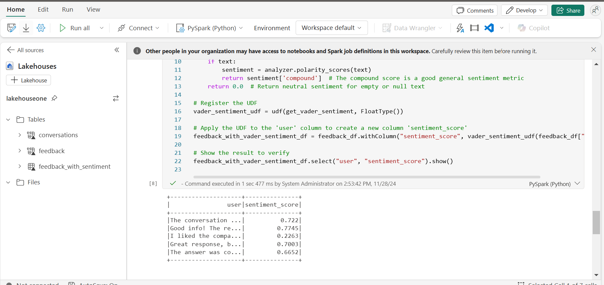
LLM Analytics
Notebook: sentiment analysis on user/feedback

Slide 9
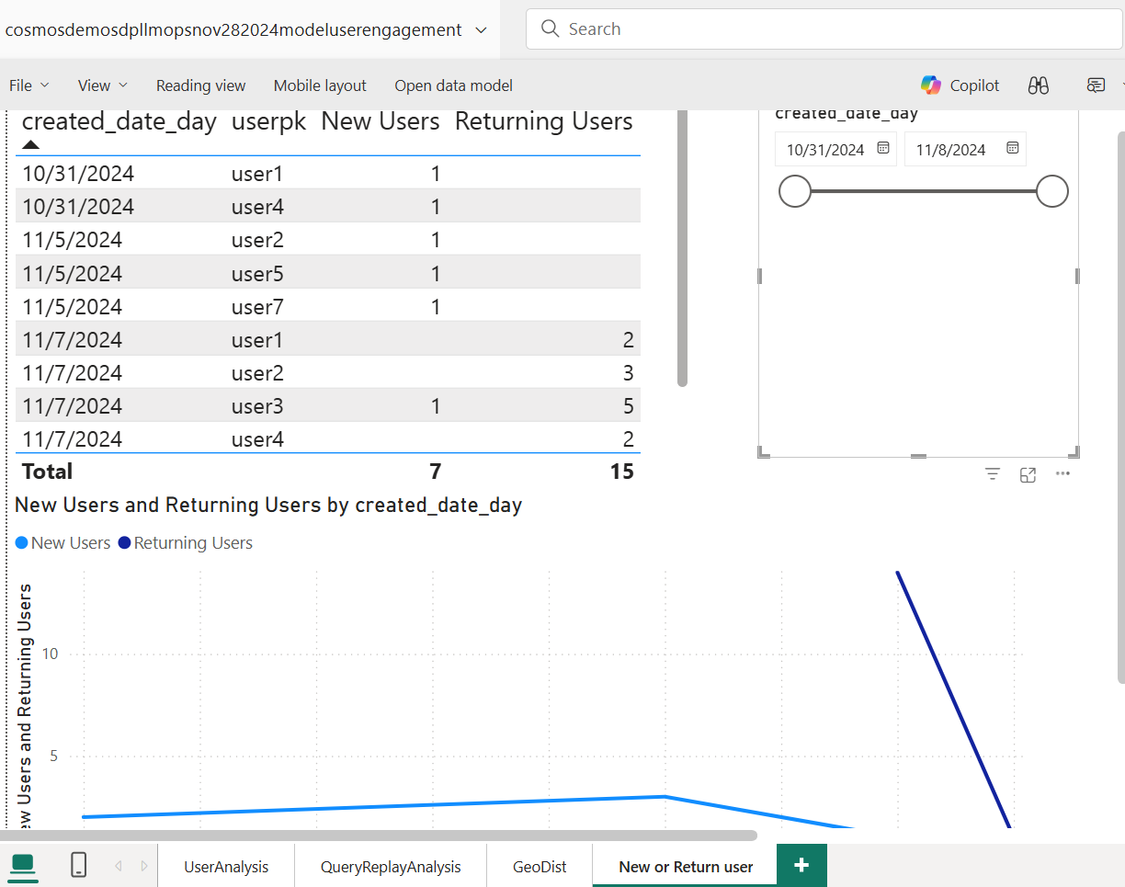
LLM Analytics
User Engagement

Slide 10
LLM Analytics
Notebook: TO BE ADDED / TOP N PROMPTS SEMANTIC CACHE

